Slide 1
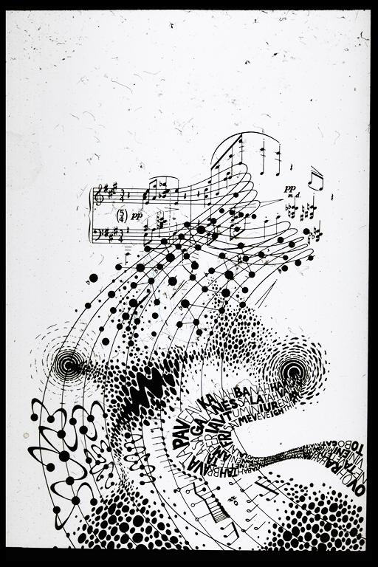
PERFORMANCE EXPOSURE THERAPY
TWELVE-TONE TUNE UP TARGETS
JOHN CHONG MD BASc MSc DOHS FRCPC FACPM CGPP ARCT
MUSICIANS’ CLINICS OF CANADA
PERFORMING ARTS MEDICINE ASSOCIATION
McMaster University/University of Toronto

Slide 2
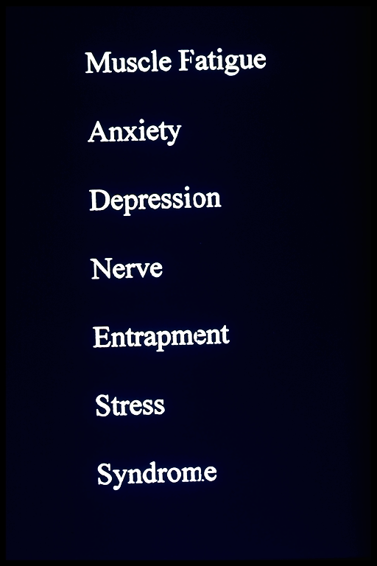
Canada Health Act 1984
Organization
Of
Canadian
Symphony
Musicians
Musicians’
Clinics
of
Canada
1986
2020
Universality Accessibility Portability

Slide 3
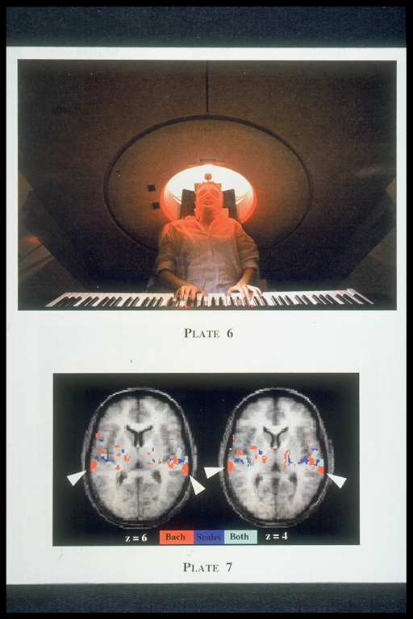
PHYSICIANS
AUDIOLOGISTS
THERAPISTS
TRAINERS
EDUCATORS
RESEARCHERS
PERFORMERS
ADMINISTRATORS
STUDENTS
(artsmed.org)
Medical
Problems
of
Performing
Artists
PERFORMING
ARTS
MEDICINE
ASSOCIATION
IMPROVING
THE
WELL BEING
OF
PERFORMING
ARTISTS
1983
Dr Alice
Brandfonbrener

Slide 4
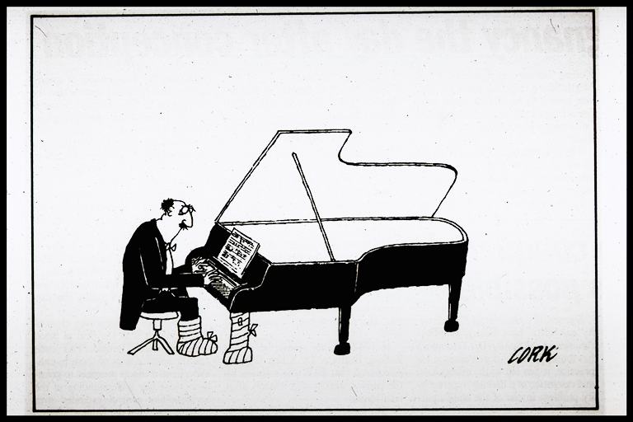
AWARENESS OF PERFORMANCE STRESS
NEUROBIOLOGY OF INJURY AND ILLNESS

Slide 5
PERFORMING ARTISTS’ INCOMES Kelly Hill presentation at Toronto PAMA Regional Meeting 2015
Actors and comedians $17,480
Dancers $12,641
Musicians and singers $15,880
Other performers $14,810
(Source: 2011 National Household Survey Canada)

Slide 6
Common risk factors for musicians
84% Lifetime Prevalence of Injury
50/50 chance of playing hurt
Excess muscle tension: 82.4 per cent
Long practice sessions: 82.0 per cent
Insufficient rest: 80.5 per cent
Poor posture: 77.9 per cent
Muscle fatigue: 76.8 per cent
Sudden increase in playing: 75.5 per cent
Repertoire scheduling: 71.7 per cent
Stress: 69.6 per cent
Lack of fitness: 67.0 per cent
Insufficient warm-up: 66.7 per cent
Musculoskeletal Pain and Injury in Professional Orchestral Musicians in Australia, by Bronwen Ackermann, Tim Driscoll and Dianna Kenny. (2012)

Slide 10
Working in the Australian Entertainment Industry Dr J van den Eynde, Prof A Fisher, Assoc Prof C Sonn; Victoria University; October 2016
WHO PARTICIPATED:
2904 Respondents across all sectors of the Entertainment Industry from all States and Territories of Australia
Group 1: Performing Artists and Music Composers (including musicians, radio presenters, actors, singers, entertainers or variety artists, dancers or choreographers, television presenters, composers, music professionals and music directors)
Group 2: Performing Arts Support Workers (including media producers, film and video editors, program director, director, production assistants, video producer, film, television and stage directors, technical director, make-up artist, director of photography, stage manager, venue manages and artistic directors)
Group 3: Broadcasting, Film and Recorded Media Equipment Operators (includes sound technicians, camera operators, projectionist, light technicians, television equipment operators, roadies, performing arts technicians)

Slide 11
Key Findings
CULTURE:
The majority of Australian entertainment industry workers express an overwhelming passion for their creative work.
There is a powerful, negative culture within the industry including a toxic, bruising work environment; extreme competition; bullying; sexual assault; sexism and racism.
There are high levels of mental health problems and suicidality.
INCOME:
35% of all workers earn an annual industry income below $20,000
72.5% of workers earn less than $60K annually from the entertainment industry
65% have a combined income below $60K from earning within and outside the entertainment industry
4.6% have been generating their primary income from the Entertainment Industry for 2-15 years
63% of Performers, 28% of Support Workers and 20% of Technicians/Crew earn less than the minimum wage of $34,112

Slide 12
WORK & SLEEP PATTERNS
Working unpredictable hours
43.1% of workers work most of the time in the evenings and night
41.9% work on the weekends
30.2% always work unpredictable hours
This is well over general population shift work patterns where 16% of the general population are shift workers.
Sleep disorders
44% of workers don’t get enough sleep
45.5% have disrupted sleep.
6% of the population has a chronic sleep disorder. Workers suffer sleep disorders 7 times greater.
Insomnia
16% of workers suffer from insomnia which is three times greater than general population at 5.6%.
Impact of irregular work patterns and sleep disorders
57.9% workers have problems finding time for their families,
63% have trouble maintaining a social life
45% have trouble keeping contact with their friends in the industry

Slide 13
MENTAL HEALTH
Diagnosis of a Mental Health Disorder in their lifetime
The most common mental health diagnoses reported across the three groups is depression and anxiety.
44% of industry workers have moderate to severe anxiety. This is 10 times higher than the general population.
The levels of depression symptoms are five times higher than general population scores.
Sought Professional Assistance for Mental Health Issues
Overall 59.5% workers have sought professional assistance for their mental health issues.

Slide 14
SUICIDE Ideation and Planning
Suicide attempts for workers are more than double that of the general population.
In the last twelve months road crew members experienced suicide ideation almost 9 times more than general population.
In the last twelve months workers experience suicide ideation from 5-7 times more than the general population and 2-3 times more over a lifetime.
Suicide planning for workers is 4-5 times more than general population

Slide 15
Drug and Alcohol Use
Alcohol use and drug use for non-medical reasons are at very high levels compared to the general population
alcohol (at 11-19 standard drinks in one day) is consumed at double the rate,
meth/amphetamine use is 8 times greater,
ecstasy use is 7 times greater,
cocaine use is 12 times greater,
marijuana use is 4 times greater,
pain killers for non-medical reasons is 7 times greater,
tranquillizers for non-medical reasons is 9 times greater
than the general population in NDSHS, 2013
A critical finding, across most types of drug use is that more than 20% of the respondents selected
“I am addicted”
compared to 4.5% for the general population

Slide 16
Adverse childhood experiences, or ACEs, are potentially traumatic events that occur in childhood (0-17 years).
experiencing violence, abuse, or neglect
witnessing violence in the home or community
having a family member attempt or die by suicide
substance misuse
mental health problems
instability due to parental separation or household members being in jail or prison

Slide 17
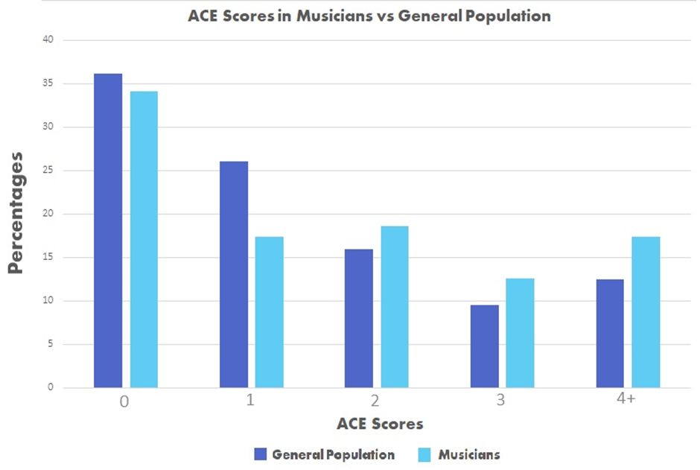

Slide 18
The number of ACE's for the clinics patients is significantly higher than that of the general population
From the highest to the lowest impact of ACE scores:
Patients' ACE scores accounted for the variability in their stress scores by 18.7%
Patients' ACE scores accounted for the variability in their DASS scores by 15.3%
Patients' ACE scores accounted for the variability in their anxiety scores by 13.4%
Patients' ACE scores accounted for the variability in their sleep scores by 11.8%
Patients' ACE scores accounted for the variability in their pain intensity scores by 2.5%
ACE scores did NOT contribute to patients' pain interference scores or depression scores.

Slide 19
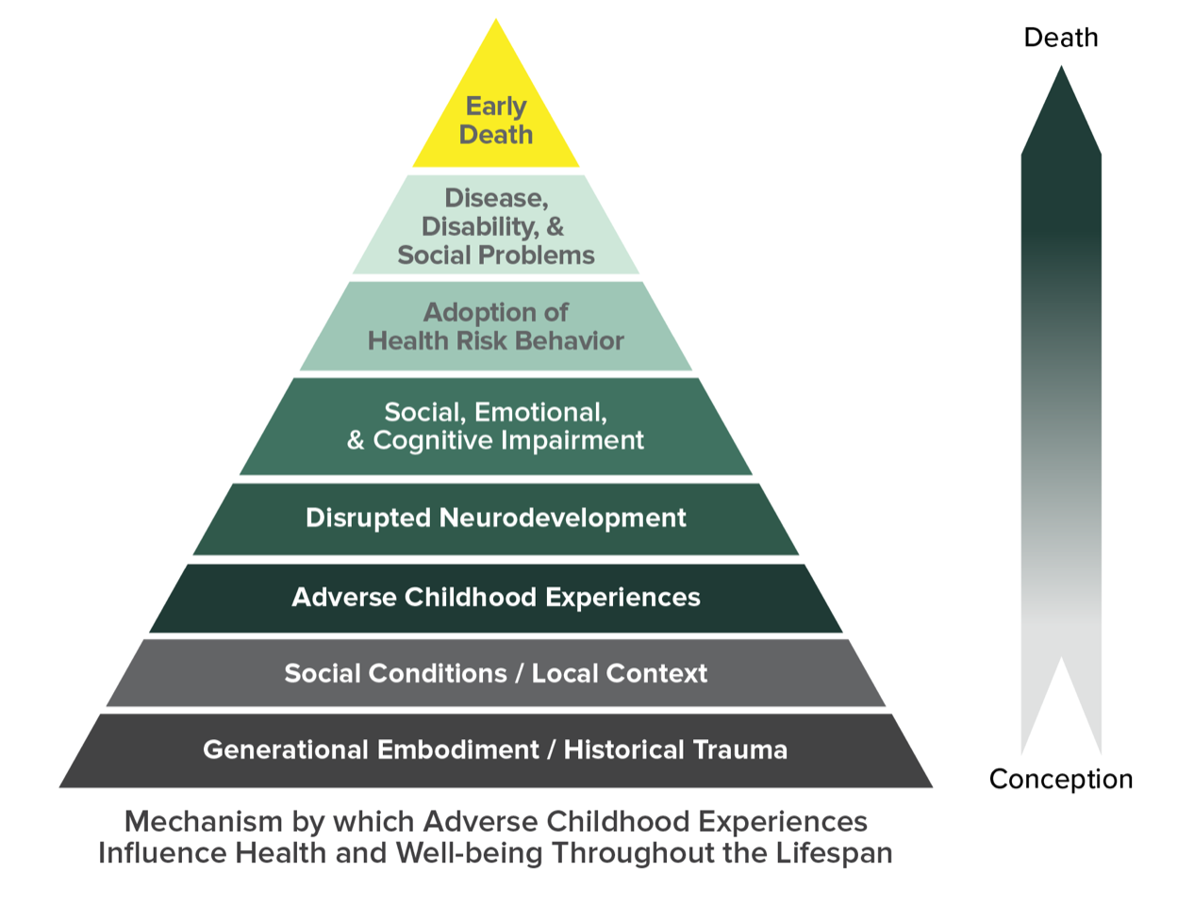

Slide 21
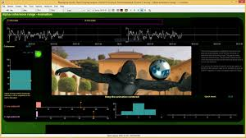
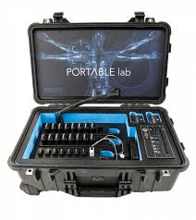
PERFORMANCE EXPOSURE THERAPY TWELVE-TONE TUNE UP TARGETS
A - Awareness - Neurobiology of Stress
A# - Anxiety - Performance Anxiety
B – Boundaries – Traumatic Experiences
C – Cognition - Mind/Body Connection
C# - Control - Perfectionism
D – Depression - Bipolar Disorder
D# - Dependence - Addiction
E – Exercise - Nutrition
F – Fatigue – Recovery/Sleep
F# - Focus - Deep Practice
G – Goals – Work/Lifestyle Balance
G# - Graduation – Resilience/Creativity
Adapted from Prolonged Exposure Cognitive Behavioural Therapy

Slide 22
CREATING THE RESILIENT PERFORMER
ALIGNMENT
BREATHING
COORDINATION
DIET
EXERCISE
FOCUS
GOALS

Slide 23
CREATING THE RESILIENT PERFORMER
SURFACE ElectroMyoGraphy
MOTION IMU Analysis
AUDIO/VIDEO Feedback
HEART RATE VARIABILITY Analysis
NEUROBIOFEEDBACK Analysis
PSYCHOTHERAPY MBSR CBT PET
Transcranial DIRECT CURRENT STIMULATION
ACUPUNCTURE
MEDICATIONS

Slide 24
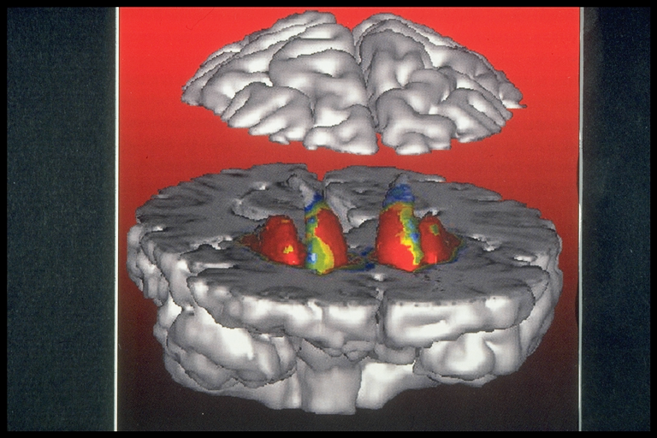
PERFORMANCE EXPOSURE THERAPY
ARTISTS’ PSYCHOPHYSIOLOGY AND ERGONOMICS LAB (APELab)
MONKEY
SEE
MONKEY
DO

Slide 25
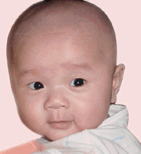
THANKS FOR YOUR ATTENTION
QUESTIONS

